Slide 1
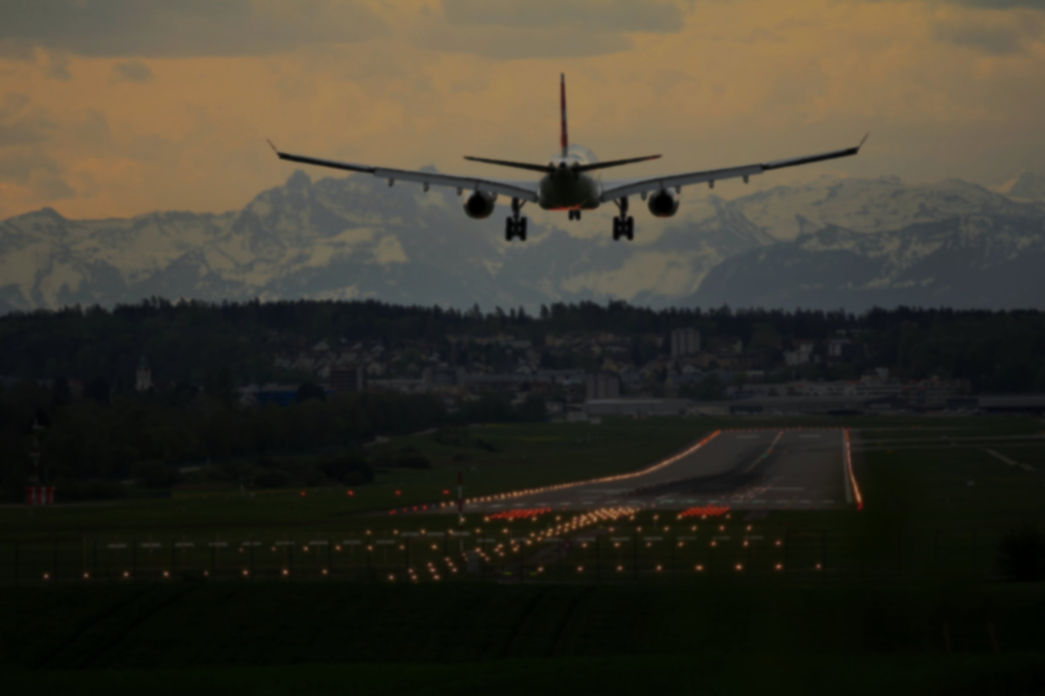

Assessing the Global COVID-19 Impact on Air Transport with Open Data
Rainer Koelle
Fabio L. C. Barbosa
Notes:
Photo by Pascal Meier on Unsplash

Slide 2




ACKNOWLEDGEMENTS
Co-author / joint paper & bi-lateral cooperation of DECEA and EUROCONTROL
Fabio L. C. Barbosa, MSc
Rainer Koelle, PhD
The authors would like to thank all contributors and individuals supporting the effort of building an open data environment for air transportation and air navigation related research at ouraiports.com and Opensky-Network.

Slide 3
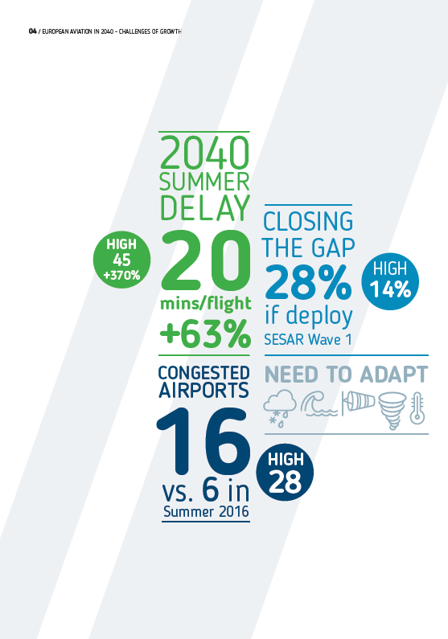

INTRO / BACKGROUND
Until 2019, the challenge was how to accommodate the increasing air transport demand into the ATM capacity.
COVID-19 posed a different, inverted situation: how to deal with insufficient demand?
Notes:
Source:
EUROCONTROL (2018). Challenges of Growth.
Photo by CDC on Unsplash.

Slide 4
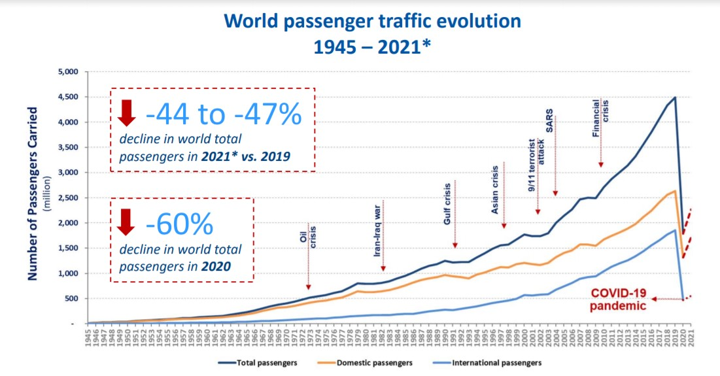
INTRO / BACKGROUND
COVID-19 impact: an unprecedented crisis in air transport.
The notion of resilience gains a renewed interest and needs to be revisited to encapsulate the new scenario. Previous approaches include:
EUROCONTROL (2009)
Gluchshenko (2012)
Project Resilience2050 (2015)
Koelle (2015)
Source: ICAO(2021)

Slide 5

INTRO / BACKGROUND
The current paper contributes to:
Provide a conceptualisation of the COVID-19 impact on air transportation as a resilience problem;
Propose a novel methodology to describe disruption, transformation, and recovery phenomena of the air transport network;
Identify patterns and/or measures to describe and quantify/evaluate the level of impact of COVID-19 on air transport and the level of recovery based on open data.
Notes:
Photo by Chris Liverani on Unsplash

Slide 6

METHOD/MATERIALS
Use of public, open data and tools
Opensky-Network.org
Ourairports.com
Flanders Maritime Institute
Rstudio and R packages (Markdown, Knitr, Ggplot, etc.)
GitHub repository
Notes:
Photo by Markus Spiske on Unsplash

Slide 7
APPROACH
OSN
Data cleaning & geo-referencing
Global flight data (monthly files, available at https://zenodo.org/record/5092947#.YRO5s4gzaMo )
Geo-referencing of non-associated departure/destination aerodromes
“commercial” traffic ~ removal of light-types (piston engine) and helicopters
Use-case analysis for Brazil, Europe, and United States
Paper & reproducibility (code, data available via github)
Airport
EEZ
Assessment
Results & reproducibility

Slide 8
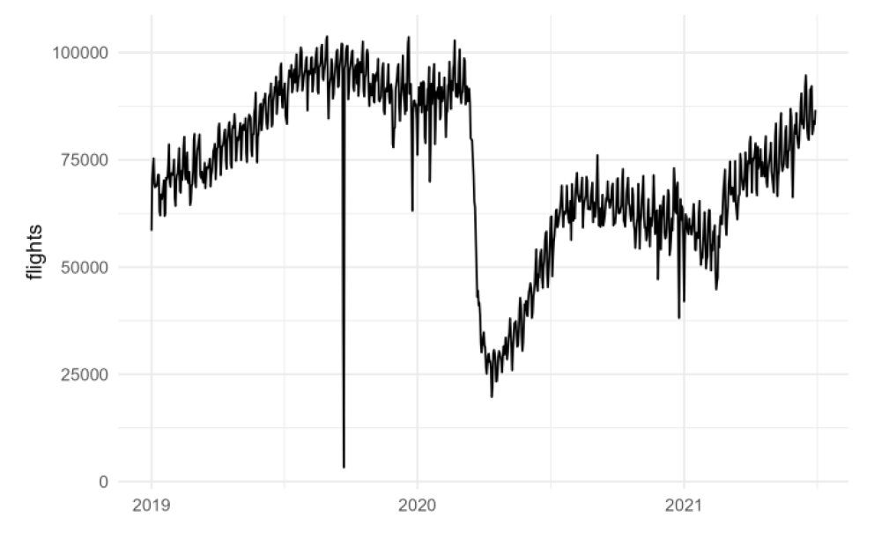
Increasing rate of ADS-B equipage, particularly in the US (NextGen mandate)
Peak 104k
Med
88k
COVID-19 main disruptions
Diverse recoveries worldwide
Data outage
Sep 22

Slide 9
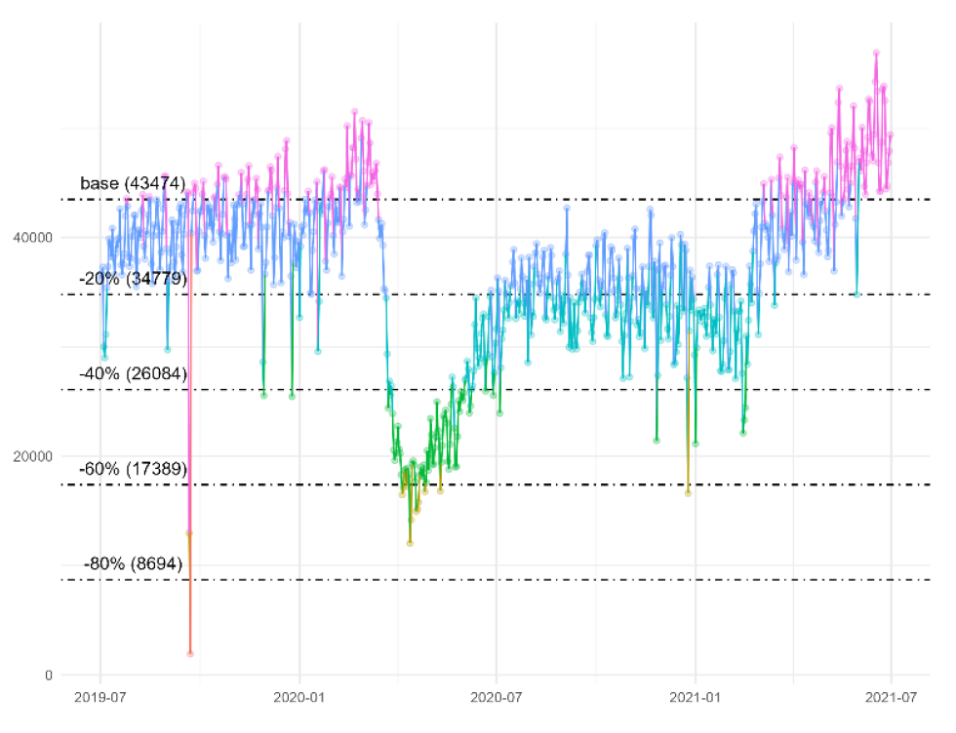
METHOD/MATERIALS
Measuring resilience:
Resilience can be conceptually measured as the observed loss in quality of service (performance) over the time to recovery for a certain level of disruption.
Fixed values to establish thresholds
Thresholds define nominal and non-nominal (disrupted) scenarios
As a base-level, the 80th percentile of the observed traffic in the 2nd half of 2019 was chosen
This paper applies a cut off of -20% from the base level as a threshold to label traffic as disrupted

Slide 10
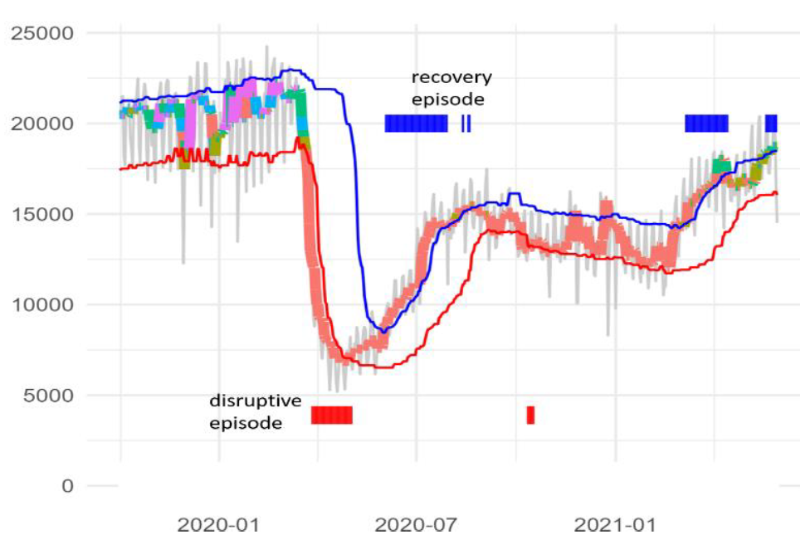
METHOD/MATERIALS
However, an evident question arises from this approach: what is the proper threshold for the service to be considered disrupted?
Measuring resilience (alternative approach):
Variable values to establish thresholds
Nominal/Non-nominal thresholds are an adaptive function of recent traffic levels
Instead of a horizontal line (fixed value), the disruption threshold adapts according to the recent trends in traffic.
The red line is the disruption threshold, defined as the 20th percentile of the daily traffic considering the previous 60 days.

Slide 11
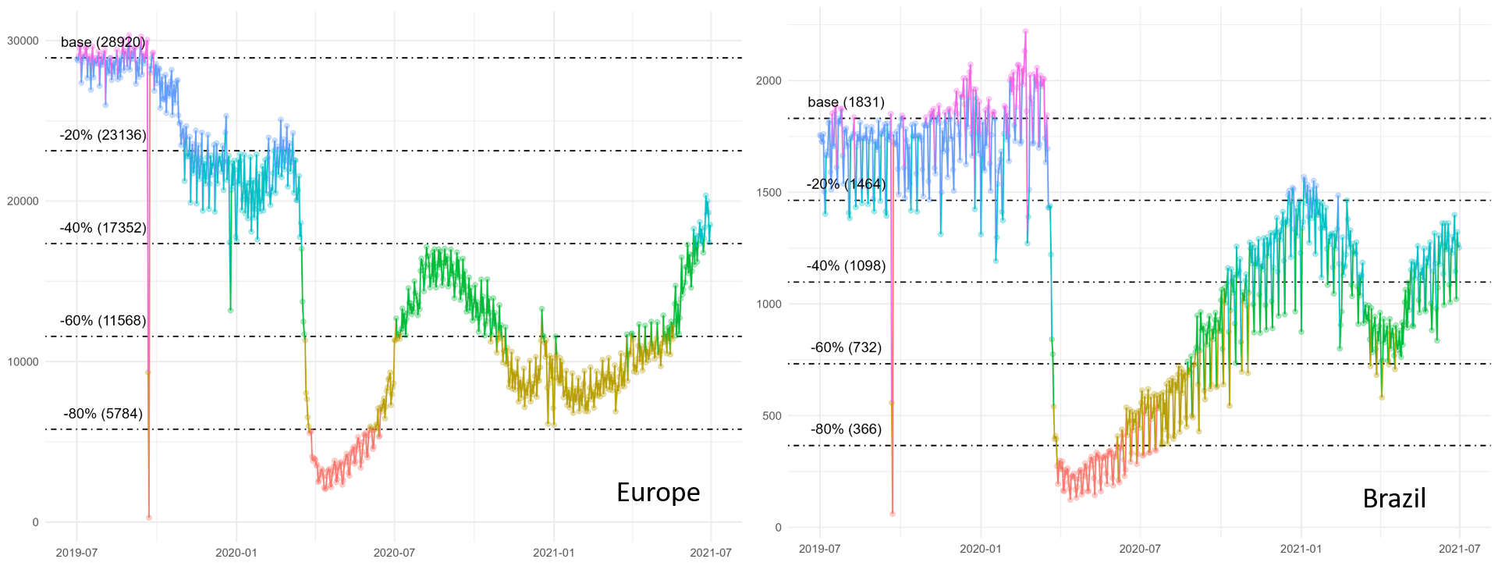
RESULTS / DISCUSSION Network Level Assessment with open data
Same method applies to other regions, and reveals different disruption levels, allows comparison between different regions

Slide 12
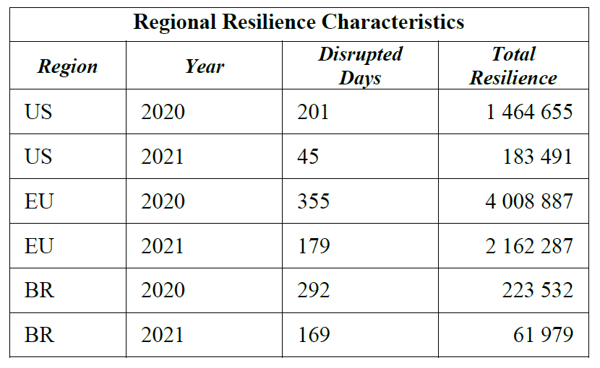
RESULTS/DISCUSSION
Europe was hit hardest, both in terms of disrupted days and the total resilience impact

Slide 13
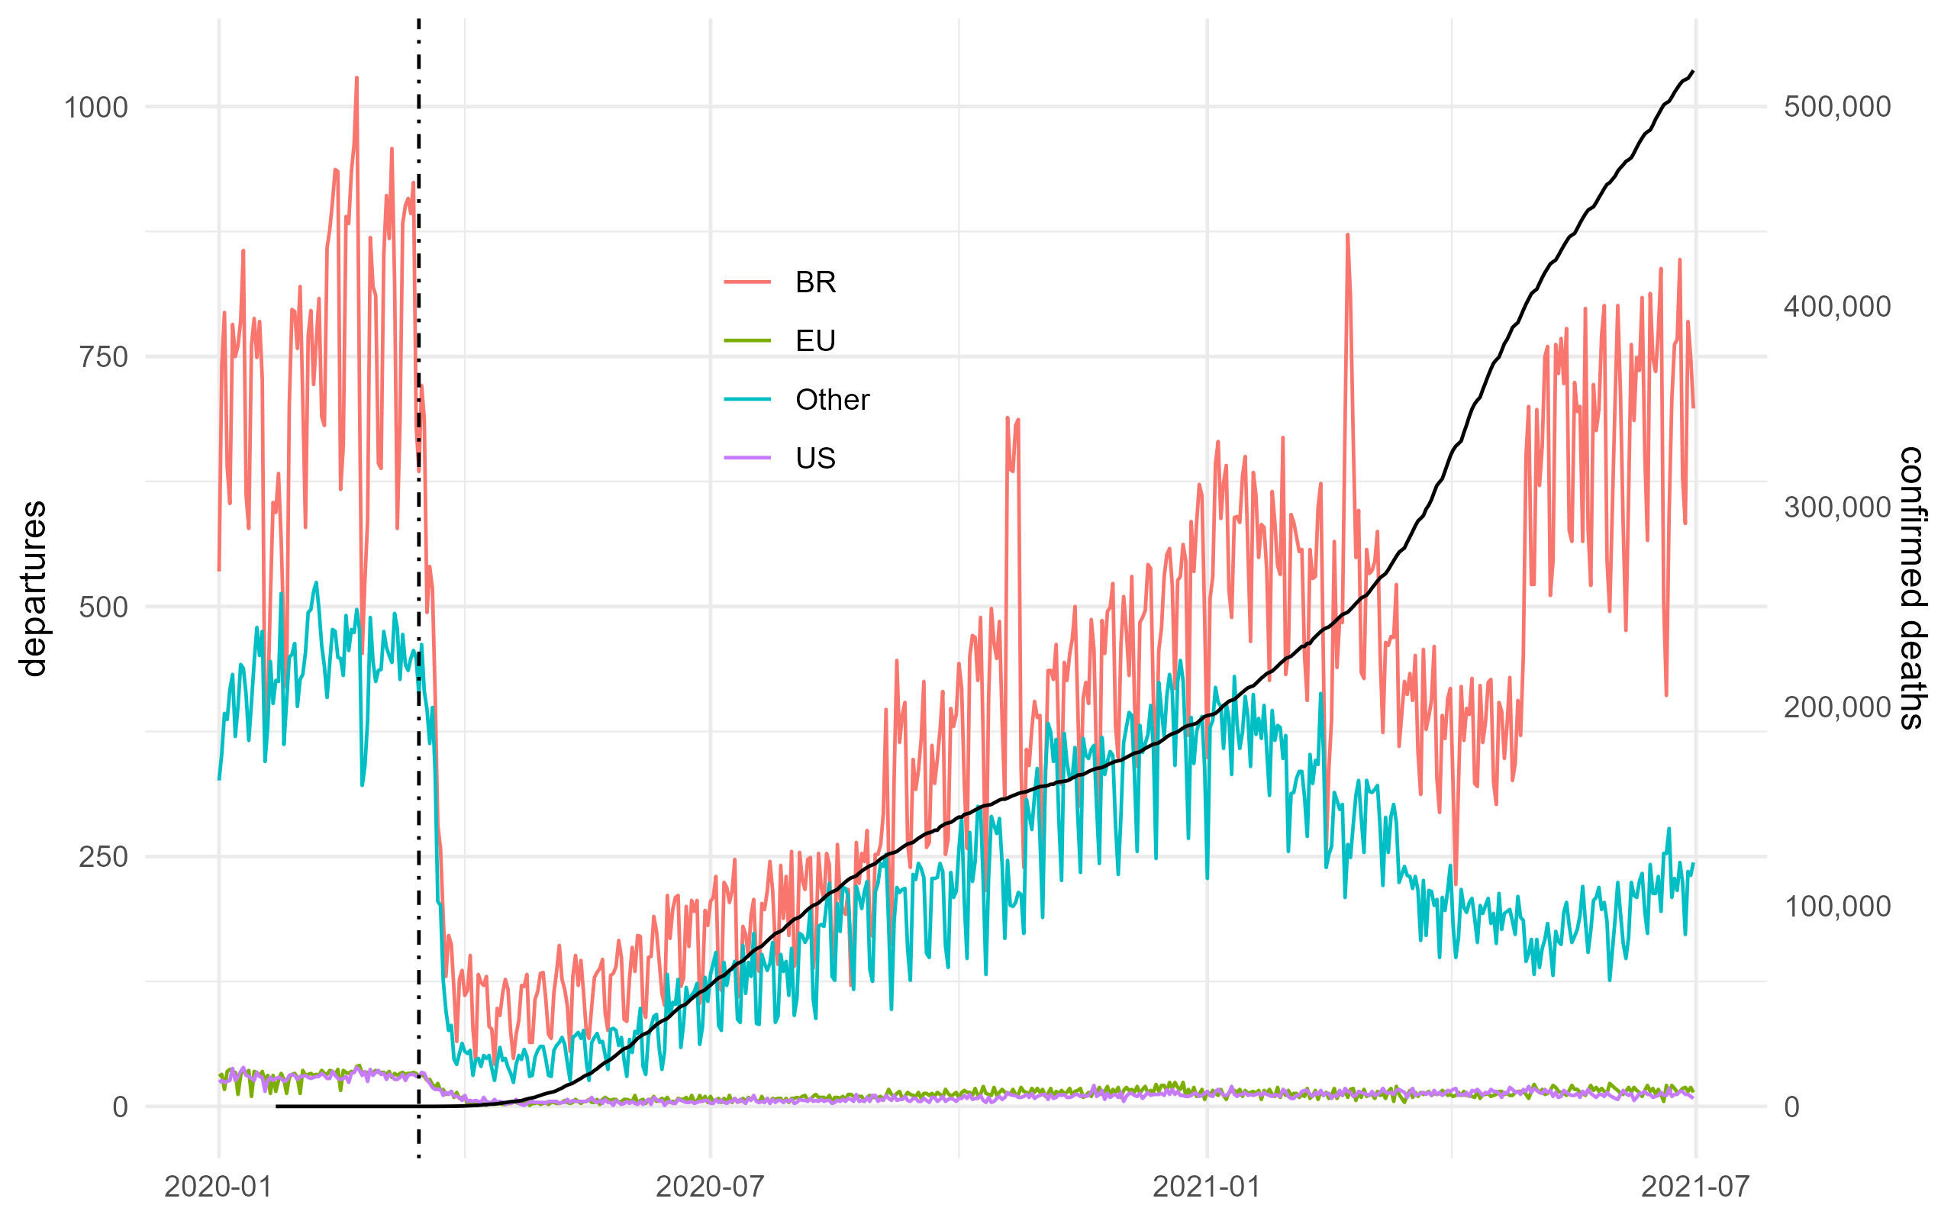
RESULTS / DISCUSSION Traffic Development and COVID-19 with open data
With a view to link this to the driver of the policy decision-making, the next step investigates the relationship between the regional infection rate progress with open data.
The following example shows the observed departure traffic in Brazil and its destinations. Traffic to the United States and Europe form a small share of the international traffic. Other traffic includes traffic to South American countries.
The steady increase of death cases increased as of late January 2021 and resulted in a stronger reduction of travel, both for domestic and international traffic

Slide 14
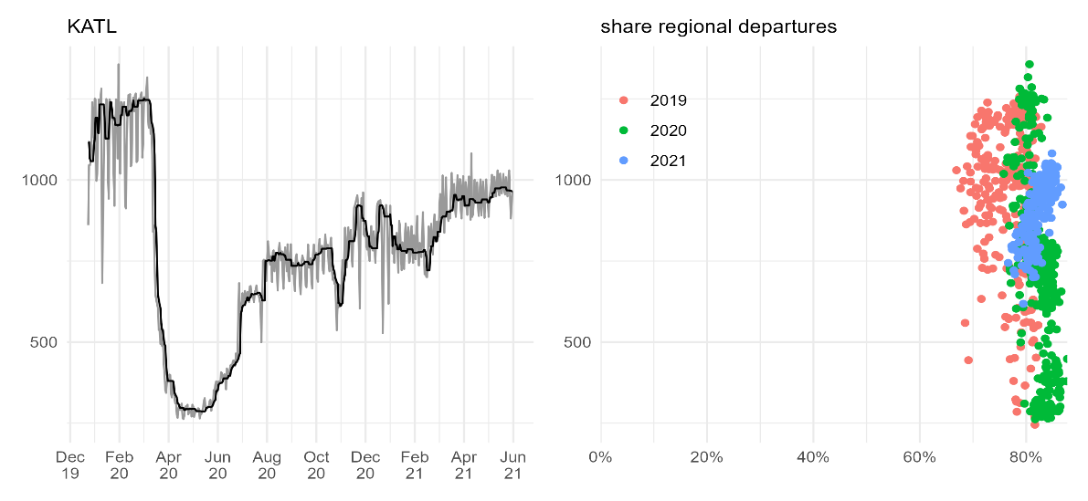
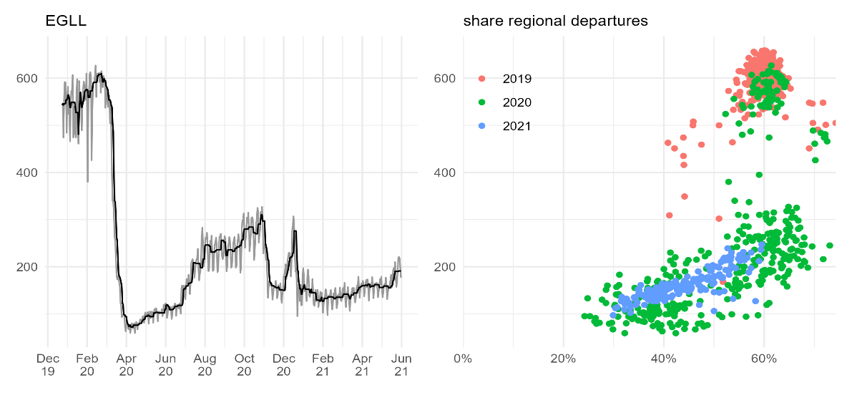
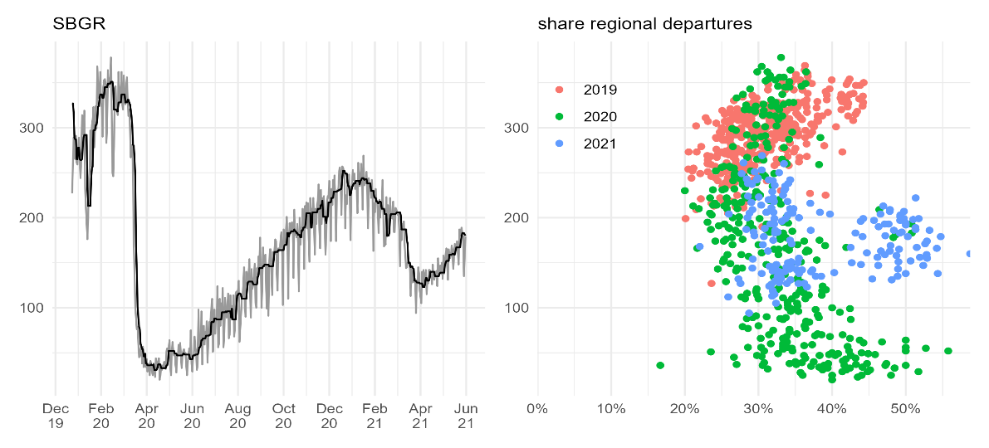
RESULTS / DISCUSSION Airport Level Connectivity
The share of national traffic at Atlanta (KATL) remained fairly stable ranging around 80%.
London Heathrow (EGLL) showed a different behaviour.
For Guarlhos (SBGR) The importance of local traffic (intra-Brazil) can be seen in the increase of the share of regional departures while the number of international departures reduced

Slide 15
CONCLUSION AND FUTURE WORK
The methodologies can be useful to support the monitoring of the recovery levels across the globe. It complements the toolbox for policy makers and strategic planers.
The regional comparison of Brazil, Europe, and the United States revealed different patterns on both the national/regional level and the local airport level.
The paper demonstrates the feasibility to refine the existing body of knowledge on resilience and adapt the concept to air transport network assessments.

Slide 16
CONCLUSION AND FUTURE WORK
A key aspect of the work presented is the use of open data as no public global data set on air traffic exists.
The combination of different open source data sets identified a need for a wider community discussion
The use of pattern recognition or clustering techniques may help to augment the association of tracked flights in future work
Reproducible research approach: Interested practitioners and researchers are able to access the underlying data and validate the results

Slide 17
Contacts
Paper source:
https://github.com/rainer-rq-koelle/paper-2021-DASC-COVID19
Rainer Koelle, PhD
Performance Review Unit
EUROCONTROL
Brussels, Belgium
rainer.koelle@eurocontrol.int
Fabio L. C. Barbosa, MSc
Subdepartment of Operations
DECEA
Rio de Janeiro, Brazil
barbosaflcb@fab.mil.br

